Slide 1

Retail Analytics Dashboard
Analyzing Warehouse Performance & Inventory Management
PRESENTED BY: VAISHNAVI SWAPNIL RAUT

Slide 2
Goal of the Project
The primary objective was to empower the retail company to make data-driven decisions by Analyzing product-level data across pricing, reviews, stock availability, and return policies, rating. The focus was on improving:
Business Operation
Customer satisfaction
Business Problem
The company was struggling with:
Stock mismatches across warehouses
Difficulty in understanding how return policy affects sales
Lack of clarity in how customer feedback (reviews/ratings) impacts product performance
Inability to calculate profitability due to missing cost data

Slide 3
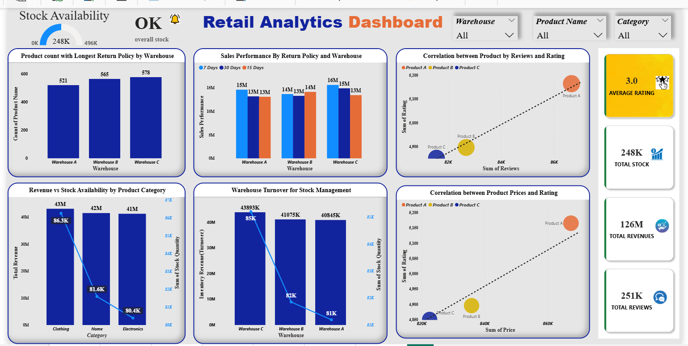

Slide 4
Strategic Recommendations for Business Growth
Stock Management
Manage Stock for Clothing items
Use sales data to forecast demand.
Keep an eye on stock vs sales to avoid overstock or running out.
Best Practices
Use Warehouse C Strategy for retail growth of Warehouse A and B (just assumption)
Use 7 days return policy for inventory cost
Marketing Strategy
Highlight premium product ratings.
Promote product on festivals as offer
Use positive reviews to build trust.
Promote top-rated products using customer feedback.

Slide 5
Profitability Analysis(Stock Management)
Finding: Profit margin cannot be calculated with the current data.
Reason: The dataset is missing the Cost column and selling units , which is essential for this calculation.
Formula:
Profit = Selling Price − Cost price
Profit Margin = ( Revenue-cost)/ Revenue) × 100 )

Slide 6
Thank You!

